Slide 1
Radio Signal Characterization
CSC219
Steven Mackey

Slide 2
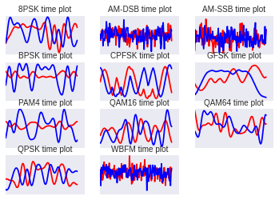
Problem and motivation
There are MANY different radio signal types (modulations)
We’ll use AM and FM (think of a car radio) as familiar examples...

Slide 3
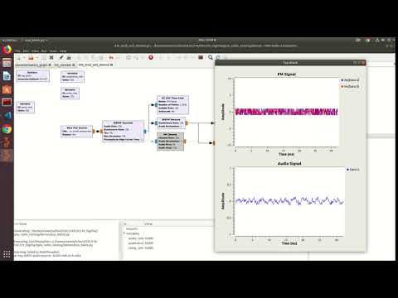
Problem and motivation (cont.)
This is what an FM signal sounds like if you use an FM demodulator...

Slide 4
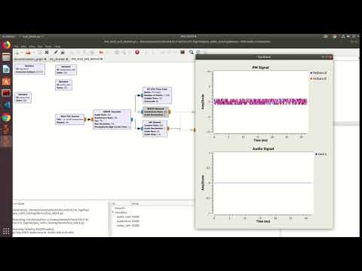
Problem and motivation (cont.)
This is what that same FM signal sounds like if you use an AM demodulator...

Slide 5
Problem and motivation (cont.)
Want to use the right demodulator... How do we classify/characterize different signal types?
Note, I’m using the words classify and characterize interchangeably

Slide 6
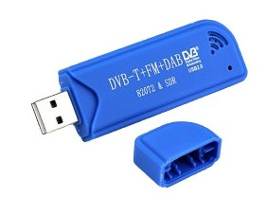
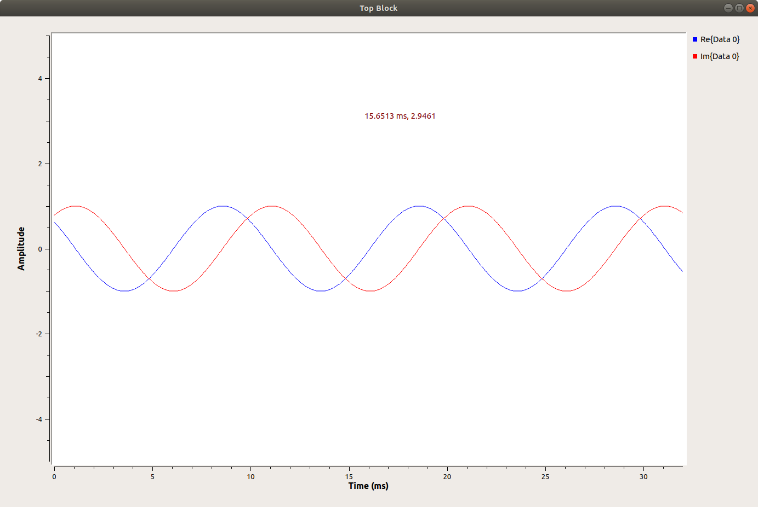
Some background info first
This is a “software defined radio”, it’s how you get data
Recall what a complex number is
Ex: 0.5+0.7i
0.5 is the real part, 0.7 is the imaginary part
One complex number is a “sample”
This is the type of data that comes out of the radio
X number of samples per second, but that’s not important
This is what the data looks like
Blue is the real portion, red imaginary
We can easily interleave (flatten) them, so that our data is effectively 1 dimensional

Slide 7
This is a lot like image recognition
The signal can be shifted “left” or “right”
The signal can be scaled up or down
Signals have distinctive shapes
It’s very similar to images, just in 1 dimension
Convolutional Neural Networks seems like the ideal approach
But there’s a catch...

Slide 8
Noisy data and SNR
When you have a weak signal, it’s noisy
Think of it like a grainy picture
SNR is “Signal to noise ratio”
When you hear static on your car radio: Low SNR

Slide 9
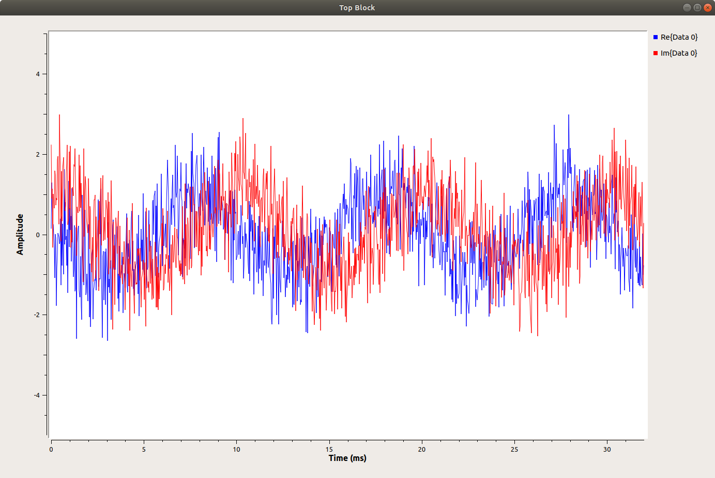
Noisy data and SNR (Cont.)
Strong signal (High SNR) vs Weak signal (LOW SNR)

Slide 10
Noisy data and SNR
There’s some math behind SNR, it can be negative
But that’s not important, just remember, higher snr -> clearer signal
Even with noise, Convolution should work, right?

Slide 11
Scope of the project
Classify radio signals
But also, general techniques for convolution

Slide 12
The Dataset
Freely available online at https://www.deepsig.io/
2 Million examples
Each example 1024 samples -> 2048 floats
24 signal types
26 SNRs ranging from very weak to very strong
Too much data! Can’t train reasonably
Select only a reasonable range of SNR
My subset of the data is all 24 signal types, and 6 SNRs
-> 59000 examples

Slide 13
Technical challenges of training CNN
Using Tensorflow, with hardware acceleration on an Nvidia GTX1080
Spent a lot of time optimizing the training pipeline
Dataset can’t fit in memory
Parallelize training and pre-fetching data samples from disk
~97% utilization of GPU, not bad
TODO: How much faster is hardware acceleration’
TODO: Wattage when training

Slide 14
Finding the right architecture
Built infrastructure to train and test different architectures
TODO: Chart of results
Look how poorly deep perceptron did, CNN really does work!
Best architecture w/ 50 epochs had an accuracy of 55%, took <TODO HOURS>
TODO: Check this

Slide 15
How many epochs is enough?
Took the best architecture, trained and tested for different number of epochs
TODO: Chart of epochs vs accuracy
Looks like I was training too much...

Slide 16
Why isn’t the accuracy better?
Two causes:
Some signal types are hard
Low SNR is hard
Let’s fix these separately…

Slide 17
What are the hard cases?
TODO: Confusion matrix
Can see the network is AWFUL at classifying <TODO: Which cases are hard>
Let’s train a network that specializes in just these two types.

Slide 18
Specialized networks (Ensemble-ish?)
Train a network just for the hard cases
If the general network predicts one of the hard cases, fall back to the special network
Results:
TODO: Chart of confusion and accuracy
It works! Accuracy gain of <TODO: accuracy gain percent>

Slide 19
SNR has huge impacts on accuracy
TODO: Chart of accuracies
What happens when we train for the SNR we expect?
TODO: Chart of SNR base training

Slide 20
Conclusions
Finding the best architecture is trial and error
Need fastest train times possible so can try out different architectures
Efficient pipelining and hardware acceleration is crucial
Train network for the type of data you expect
Noisy vs. clean data
Using specialized networks is good for hard cases
References:

